Slide 1
WILGUS II
NORTH PARK
Pre Submittal Community Meeting
May 22, 2025

Slide 2
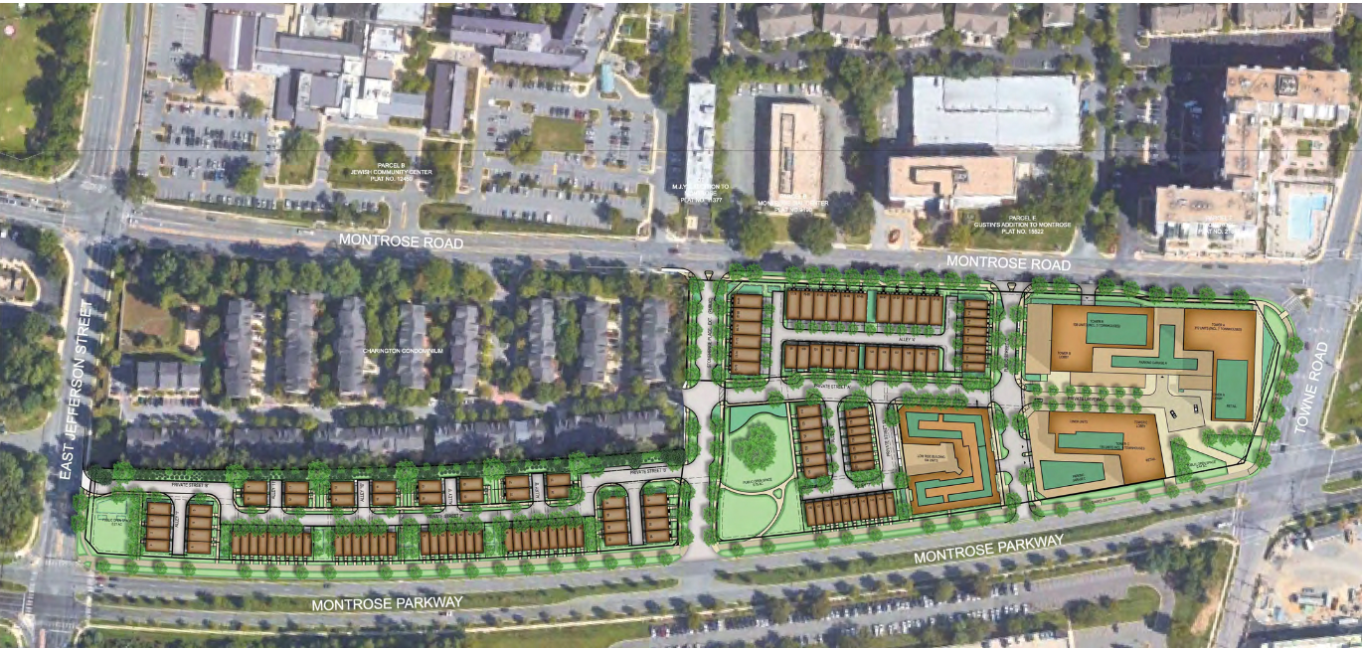
Approved Preliminary Plan (2020)
Wilgus II North Park
Pre-Submittal Community Meeting

Slide 3
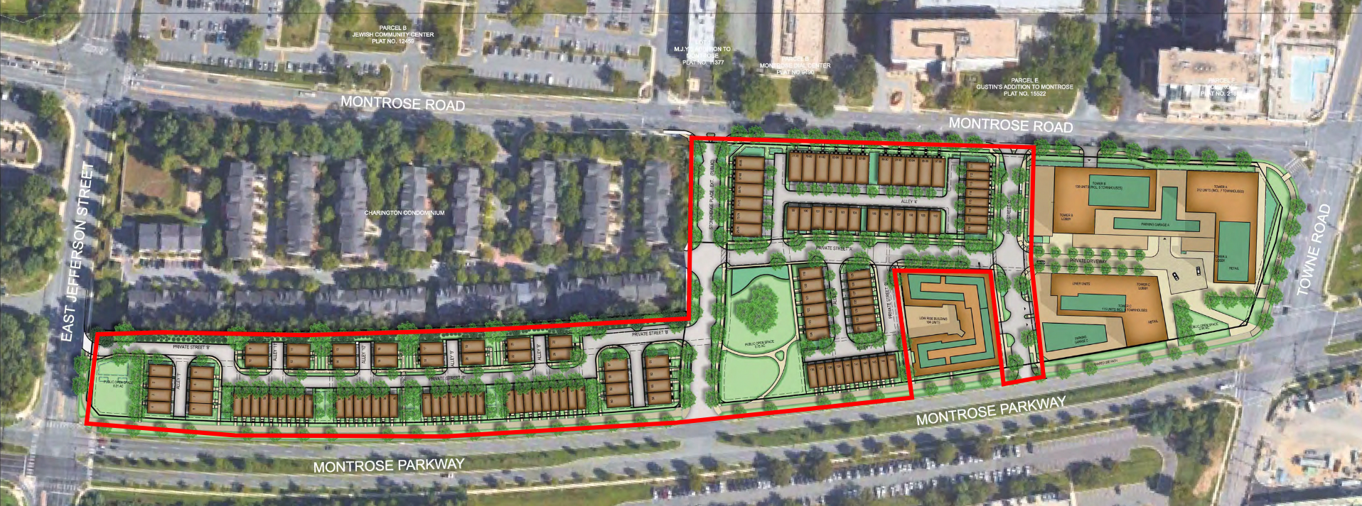
Approved Site Plan (2021)
Wilgus II North Park
Pre-Submittal Community Meeting
SITE PLAN (PHASE I)

Slide 4
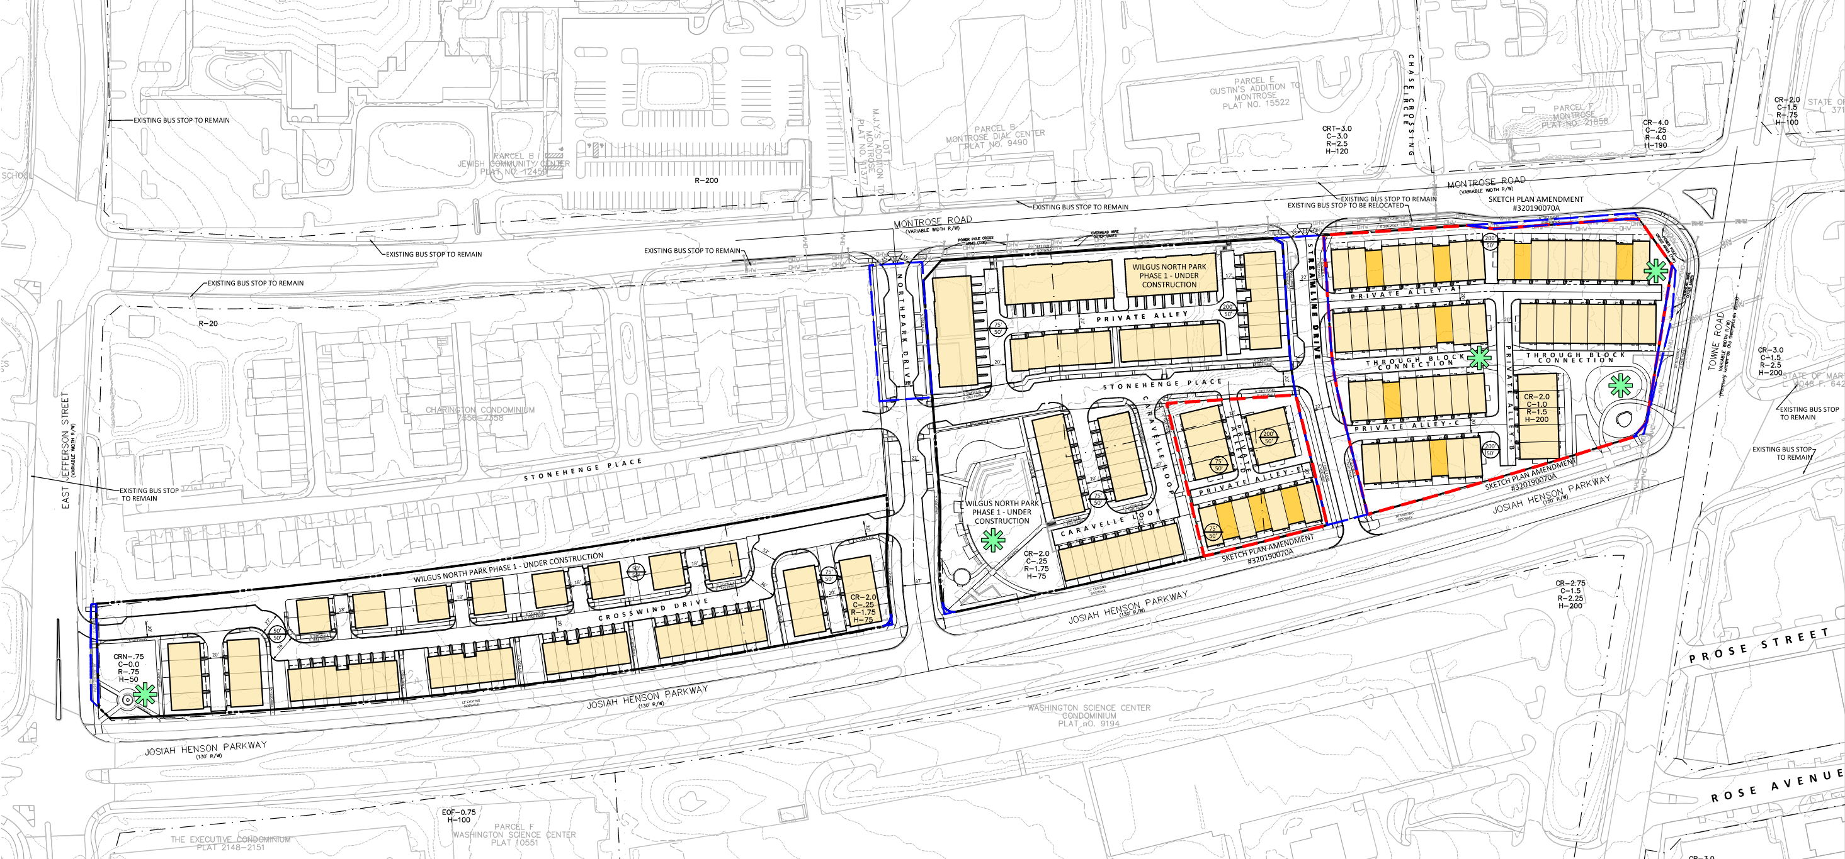
Approved Sketch Plan Amendment (2025)
Wilgus II North Park
Pre-Submittal Community Meeting
PHASE I UNDER CONSTRUCTION
PHASE 1 UNDER CONSTRUCTION
SKETCH PLAN AMENDMENT

Slide 5
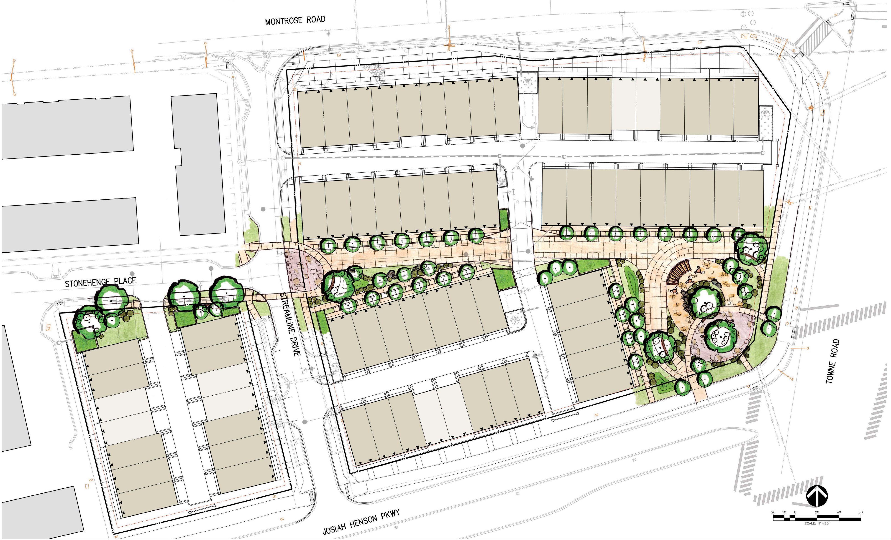
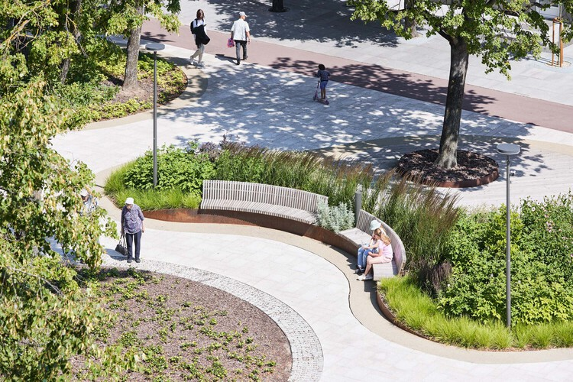
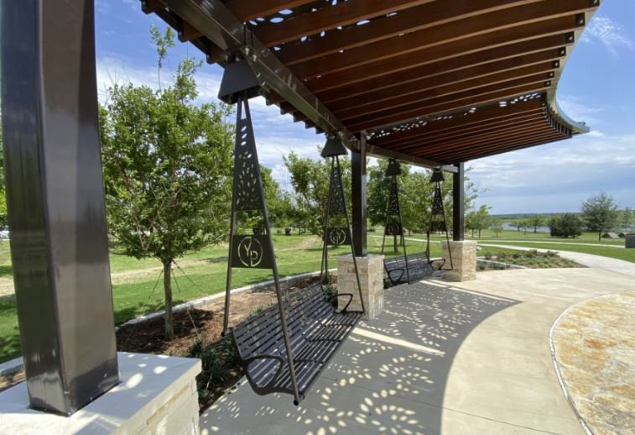

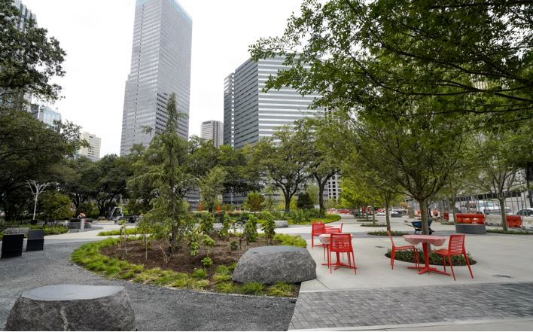
Proposed Site Plan and Preliminary Plan Amendment
Wilgus II North Park
Pre-Submittal Community Meeting

Slide 6
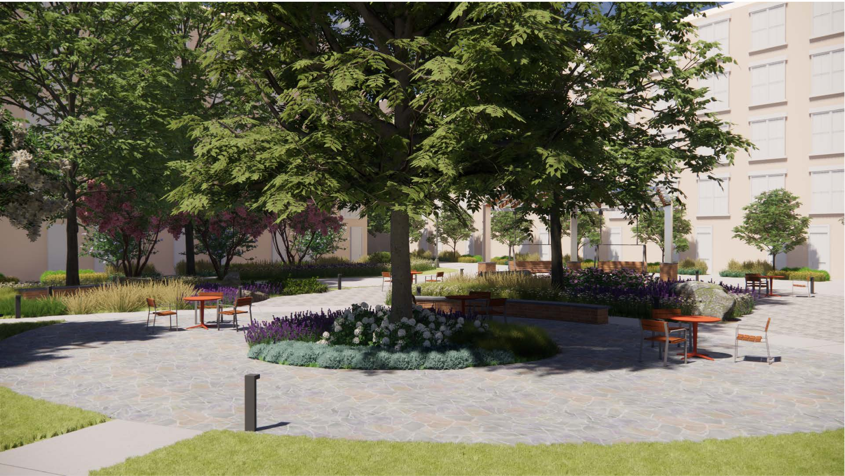
VIEW FROM THE TOWNE ROAD INTERSECTION

Slide 7
Wilgus II North Park
Discussion
Pre Submittal Community Meeting

